Slide 1
OOPs Concept in Java
~By Amar upadhyay

Slide 2
Java OOP :
OOP stands for Object-Oriented Programming.
Procedural programming is about writing procedures or methods that perform operations on the data, while object-oriented programming is about creating objects that contain both data and methods.
Object-oriented programming has several advantages over procedural programming:
OOP is faster and easier to execute
OOP provides a clear structure for the programs
OOP helps to keep the Java code DRY "Don't Repeat Yourself", and makes the code easier to maintain, modify and debug
OOP makes it possible to create full reusable applications with less code and shorter development time
Tip: The "Don't Repeat Yourself" (DRY) principle is about reducing the repetition of code. You should extract out the codes that are common for the application, and place them at a single place and reuse them instead of repeating it.

Slide 3
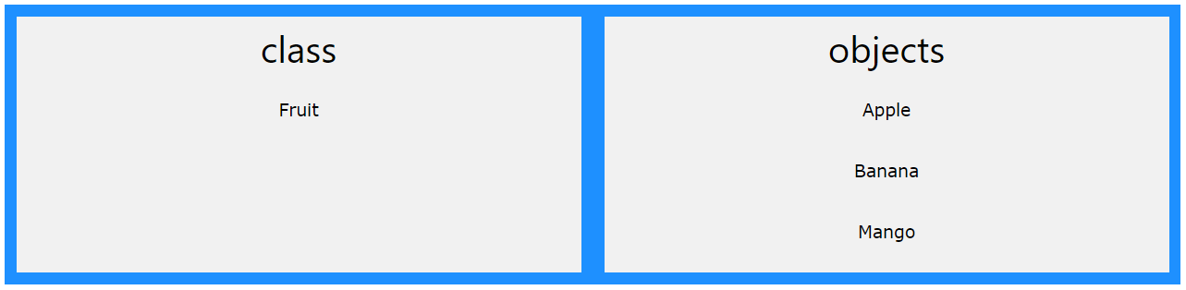
Java - What are Classes and Objects? :
Classes and objects are the two main aspects of object-oriented programming.
Look at the following illustration to see the difference between class and objects:

Slide 4
Java Classes/Objects :
Java is an object-oriented programming language.
Everything in Java is associated with classes and objects, along with its attributes and methods. For example: in real life, a car is an object. The car has attributes, such as weight and color, and methods, such as drive and brake.
A Class is like an object constructor, or a "blueprint" for creating objects.

Slide 5
Create a Class :
To create a class, use the keyword class:
Main.java
Create a class named "Main" with a variable x:
public class Main {
int x = 5;

Slide 6
Create an Object :
In Java, an object is created from a class. We have already created the class named Main, so now we can use this to create objects.
To create an object of Main, specify the class name, followed by the object name, and use the keyword new:
Create an object called "myObj" and print the value of x:
public class Main {
int x = 5;
public static void main(String[] args) {
Main myObj = new Main();
System.out.println(myObj.x);
}
}

Slide 7
Java Class Attributes :
In the previous chapter, we used the term "variable" for x in the example (as shown below). It is actually an attribute of the class. Or you could say that class attributes are variables within a class:
Example :
Create a class called "Main" with two attributes: x and y
public class Main {
int x = 5;
int y = 3;
}
You can access attributes by creating an object of the class, and by using the dot syntax (.)

Slide 8
Java Class Methods :
You learned from the Java Methods chapter that methods are declared within a class, and that they are used to perform certain actions:
Example:
Create a method named myMethod() in Main:
public class Main {
static void myMethod() {
System.out.println("Hello World!");
}
}
myMethod() prints a text (the action), when it is called. To call a method, write the method's name followed by two parentheses () and a semicolon;

Slide 9
Static vs. Non-Static :
public class Main {
// Static method
static void myStaticMethod() {
System.out.println("Static methods can be called without creating objects");
}
// Public method
public void myPublicMethod() {
System.out.println("Public methods must be called by creating objects");
}
// Main method
public static void main(String[] args) {
myStaticMethod(); // Call the static method
// myPublicMethod(); This would compile an error
Main myObj = new Main(); // Create an object of Main
myObj.myPublicMethod(); // Call the public method on the object
}
}

Slide 10
Java Constructors :
A constructor in Java is a special method that is used to initialize objects. The constructor is called when an object of a class is created. It can be used to set initial values for object attributes:
Example
//After main method
int x; // Create a class attribute
// Create a class constructor for the Main class
public Main() {
x = 5; // Set the initial value for the class attribute x
}
public static void main(String[] args) {
Main myObj = new Main(); // Create an object of class Main (This will call the constructor)
System.out.println(myObj.x); // Print the value of x
}
// Outputs 5

Slide 11
Modifiers :
By now, you are quite familiar with the public keyword that appears in almost all of our examples:
public class Main
The public keyword is an access modifier, meaning that it is used to set the access level for classes, attributes, methods and constructors.
We divide modifiers into two groups:
Access Modifiers - controls the access level
Non-Access Modifiers - do not control access level, but provides other functionality

Slide 12
Java Encapsulation :
The meaning of Encapsulation, is to make sure that "sensitive" data is hidden from users. To achieve this, you must:
declare class variables/attributes as private
provide public get and set methods to access and update the value of a private variable

Slide 13
Why Encapsulation?
Better control of class attributes and methods
Class attributes can be made read-only (if you only use the get method), or write-only (if you only use the set method)
Flexible: the programmer can change one part of the code without affecting other parts
Increased security of data

Slide 14
Java Inheritance (Subclass and Superclass)
In Java, it is possible to inherit attributes and methods from one class to another. We group the "inheritance concept" into two categories:
subclass (child) - the class that inherits from another class
superclass (parent) - the class being inherited from
To inherit from a class, use the extends keyword.
In the example below, the Car class (subclass) inherits the attributes and methods from the Vehicle class (superclass):

Slide 15
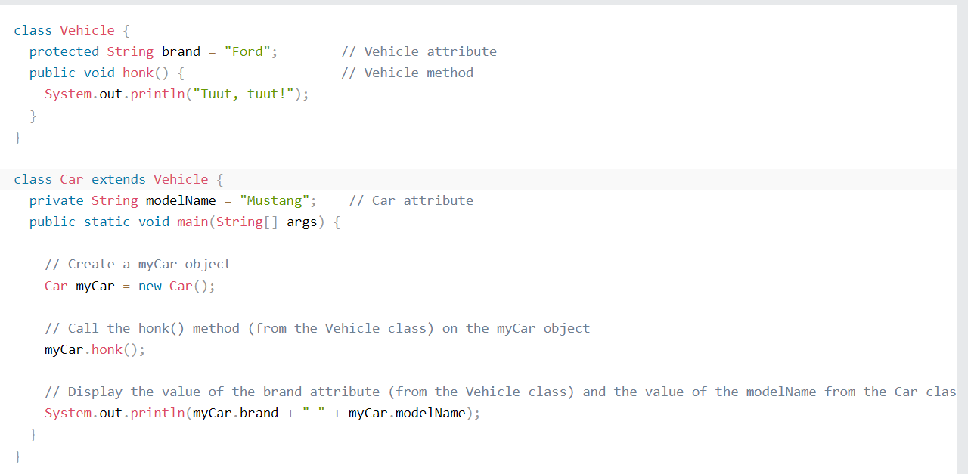
Java Inheritance Example :

Slide 16
Java Polymorphism :
Polymorphism means "many forms", and it occurs when we have many classes that are related to each other by inheritance.
Like we specified in the previous chapter; Inheritance lets us inherit attributes and methods from another class. Polymorphism uses those methods to perform different tasks. This allows us to perform a single action in different ways.
For example, think of a superclass called Animal that has a method called animalSound(). Subclasses of Animals could be Pigs, Cats, Dogs, Birds - And they also have their own implementation of an animal sound (the pig oinks, and the cat meows, etc.):

Slide 17
Java Inner Classes :
In Java, it is also possible to nest classes (a class within a class). The purpose of nested classes is to group classes that belong together, which makes your code more readable and maintainable.
To access the inner class, create an object of the outer class, and then create an object of the inner class.
There are several inner classes in Java :
Private Inner class
Static Inner Class

Slide 18
Java Abstraction : Abstract Classes and Methods
Data abstraction is the process of hiding certain details and showing only essential information to the user.
Abstraction can be achieved with either abstract classes or interfaces (which you will learn more about in the next chapter).
The abstract keyword is a non-access modifier, used for classes and methods:
Abstract class: is a restricted class that cannot be used to create objects (to access it, it must be inherited from another class).
Abstract method: can only be used in an abstract class, and it does not have a body. The body is provided by the subclass (inherited from).

Slide 19
Java Interface :
Another way to achieve abstraction in Java, is with interfaces.
An interface is a completely "abstract class" that is used to group related methods with empty bodies:
Example
// interface
interface Animal {
public void animalSound(); // interface method (does not have a body)
public void run(); // interface method (does not have a body)
}

Slide 20
Java Enums :
An enum is a special "class" that represents a group of constants (unchangeable variables, like final variables).
To create an enum, use the enum keyword (instead of class or interface), and separate the constants with a comma. Note that they should be in uppercase letters:
Example
enum Level {
LOW,
MEDIUM,
HIGH
}
You can access enum constants with the dot syntax:
Level myVar = Level.MEDIUM;

Slide 21
Java User Input :
The Scanner class is used to get user input, and it is found in the java.util package.
To use the Scanner class, create an object of the class and use any of the available methods found in the Scanner class documentation. In our example, we will use the nextLine() method, which is used to read Strings
Example :
Scanner myObj = new Scanner(System.in); // Create a Scanner object
System.out.println("Enter username");
String userName = myObj.nextLine(); // Read user input
System.out.println("Username is: " + userName); // Output user input

Slide 22
Java ArrayList :
The ArrayList class is a resizable array, which can be found in the java.util package.
The difference between a built-in array and an ArrayList in Java, is that the size of an array cannot be modified (if you want to add or remove elements to/from an array, you have to create a new one). While elements can be added and removed from an ArrayList whenever you want. The syntax is also slightly different:
Example
Create an ArrayList object called cars that will store strings:
import java.util.ArrayList; // import the ArrayList class
ArrayList<String> cars = new ArrayList<String>(); // Create an ArrayList object

Slide 23
Java Iterator :
An Iterator is an object that can be used to loop through collections, like ArrayList and HashSet. It is called an "iterator" because "iterating" is the technical term for looping.
To use an Iterator, you must import it from the java.util package.

Slide 24
Java Exceptions :
When executing Java code, different errors can occur: coding errors made by the programmer, errors due to wrong input, or other unforeseeable things.
When an error occurs, Java will normally stop and generate an error message. The technical term for this is: Java will throw an exception (throw an error).

Slide 25
Java try and catch :
The try statement allows you to define a block of code to be tested for errors while it is being executed.
The catch statement allows you to define a block of code to be executed, if an error occurs in the try block.
The try and catch keywords come in pairs:
Syntax :
try {
// Block of code to try
}
catch(Exception e) {
// Block of code to handle errors
}

Slide 26
Example of Try Catch Block :
public class Main {
public static void main(String[] args) {
try {
int[] myNumbers = {1, 2, 3};
System.out.println(myNumbers[10]);
} catch (Exception e) {
System.out.println("Something went wrong.");
} finally {
System.out.println("The 'try catch' is finished.");
}
}
}

Slide 27
Finally Keyword :
The finally statement lets you execute code, after try...catch, regardless of the result:
public class Main {
public static void main(String[] args) {
try {
int[] myNumbers = {1, 2, 3};
System.out.println(myNumbers[10]);
} catch (Exception e) {
System.out.println("Something went wrong.");
} finally {
System.out.println("The 'try catch' is finished.");
}
}
}

Slide 28
The throw keyword :
The throw statement allows you to create a custom error.
The throw statement is used together with an exception type. There are many exception types available in Java: ArithmeticException, FileNotFoundException, ArrayIndexOutOfBoundsException, SecurityException, etc:

Slide 29
Java Regular Expressions : RegEx
A regular expression is a sequence of characters that forms a search pattern. When you search for data in a text, you can use this search pattern to describe what you are searching for.
A regular expression can be a single character, or a more complicated pattern.
Regular expressions can be used to perform all types of text search and text replace operations.
Java does not have a built-in Regular Expression class, but we can import the java.util.regex package to work with regular expressions. The package includes the following classes:
Pattern Class - Defines a pattern (to be used in a search)
Matcher Class - Used to search for the pattern
PatternSyntaxException Class - Indicates syntax error in a regular expression pattern

Slide 30
Java Threads :
Threads allows a program to operate more efficiently by doing multiple things at the same time.
Threads can be used to perform complicated tasks in the background without interrupting the main program.

Slide 31
Java Lambda Expressions :
Lambda Expressions were added in Java 8.
A lambda expression is a short block of code which takes in parameters and returns a value. Lambda expressions are similar to methods, but they do not need a name and they can be implemented right in the body of a method.
Syntax
The simplest lambda expression contains a single parameter and an expression:
parameter -> expression

Slide 32
Java Files :
File handling is an important part of any application.
Java has several methods for creating, reading, updating, and deleting files.

Slide 33
Java File Handling :
The File class from the java.io package, allows us to work with files.
To use the File class, create an object of the class, and specify the filename or directory name:
Example
import java.io.File; // Import the File class
File myObj = new File("filename.txt"); // Specify the filename

Slide 34
Create a File :
To create a file in Java, you can use the createNewFile() method. This method returns a boolean value: true if the file was successfully created, and false if the file already exists. Note that the method is enclosed in a try...catch block. This is necessary because it throws an IOException if an error occurs (if the file cannot be created for some reason):

Slide 35
Write To a File :
In the following example, we use the FileWriter class together with its write() method to write some text to the file we created in the example above. Note that when you are done writing to the file, you should close it with the close() method:

Slide 36
In the previous chapter, you learned how to create and write to a file.
In the following example, we use the Scanner class to read the contents of the text file we created in the previous chapter:

Slide 37
Example : Add two numbers
import java.util.Scanner; // Import the Scanner class
class MyClass {
public static void main(String[] args) {
int x, y, sum;
Scanner myObj = new Scanner(System.in); // Create a Scanner object
System.out.println("Type a number:");
x = myObj.nextInt(); // Read user input
System.out.println("Type another number:");
y = myObj.nextInt(); // Read user input
sum = x + y; // Calculate the sum of x + y
System.out.println("Sum is: " + sum); // Print the sum
}
}

Slide 38
Thank You!

